Slide 1
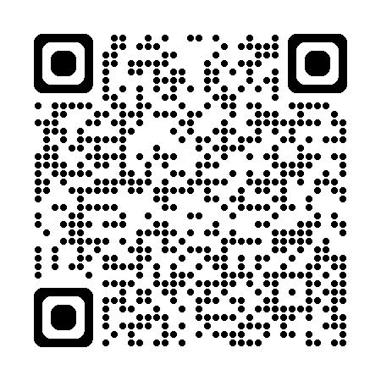

Scan the QR code to check in for the Coach's Meeting
KSA COACHES MEETING
FALL 2026
1

Slide 2
TOP 5 TAKEAWAYS
Rosters
  Notify your commissioner of any roster issues ASAP - it directly affects uniform ordering.
Game Day Musts
  U9+: jersey numbers entered into GotSport rosters
  Bring 2 printed game reports (coaches + all players with jersey #'s)
  Coach badges printed and visible at all times on the sideline - NMCSL may forfeit the game if not
  Players bring both jerseys to every game
Coach / Player / Parent Conduct
  Zero Tolerance and the new Referee Abuse Prevention Program are in effect
  Coaches are responsible for parent behavior - set expectations early
Gear
  No earrings; shin guards required
Questions?
  Reach out to your age group commissioner for help
2

Slide 3
PART 1
GETTING UP AND RUNNING
What every coach needs to complete before the season starts

Slide 4
MANDATORY COACH REQUIREMENTS
Online Coach Registration
  This is how KSA knows you're coaching, assigns you to a team, and sends you association emails.
Background Check
SafeSport Certification (Initial or Refresher)
  Required under the Protecting Young Victims from Sexual Abuse and Safe Sport Authorization Act of 2017.
  Full course only once, then a 15-30 min refresher every year (linked to your background check).
Use the same legal name and email address in both GotSport and SafeSport as your coach account.
4

Slide 5
KSA AT A GLANCE
Non-profit organization under NTX Soccer - 100% volunteer-run
U8 & under: KSA Recreational League - 80+ teams, all games at the KSA Soccer Complex
U9-U19: NMCSL (Northern Mid Cities Soccer League) - 80+ teams, played across KSA and neighboring associations
By the Numbers
1,700+
200+
150+
3,000+
Players
Coaches
Referees
Parents & Family
We are a 100% volunteer organization - from the board to every sideline coach.
5

Slide 6
TEAM FORMATION & ROSTER RULES
It is not “your” team. Don't tell a parent yes or no about being placed on “your” roster - roster decisions are KSA's, not the coach's.
Team age is set by the oldest player on the roster.
Returning players may:
  Automatically return to their previous team - GotSport controls this regardless of other notes/dropdowns, unless they mark “draw”
  Elect to go into the draw, or elect to “Return To Age” due to the Year vs School Calendar
  Request to play up one age group without board approval (Players “Returning to Team” were grandfathered in to play 2 ages up w/o Board approval)
New players may:
  Request the “buddy rule” only if they have NOT played with any NTX association in the past two seasons - it's a request, not a guarantee (teams are often full)
  Request their calendar age group or to play up
Roster questions or concerns go to your age group commissioner or to the KSA Office by email for compliance vetting - not to the coach
6

Slide 7
ROSTERS & GAME REPORTS (GOTSPORT)
View your roster
  Team Management → Team Name → Rosters → select the current Event → Search → check the Players & Coaches tabs
  Roster PDF button gives you a hard copy
Print game reports
  Team Management → Matches → find the game → (…) under Chat → Print Match Cards → Export
  Confirm both teams' NTX-approved players and coaches are listed - if your AC isn't there, they aren't approved yet
Coach badges & player IDs
  Same path as Rosters, but choose ID Cards - print for coaches and all U9+ players
All of the above is also available on the GotSport app.
7

Slide 8

GETTING YOUR TEAM READY
Contact your team within 48 hours of receiving the roster.
Set practice days and a centrally-located location
Recruit a volunteer - assistant coach, team manager, team mom/dad
Confirm background check, registration, and SafeSport for any added volunteer, and notify your commissioner before they're on the sideline
No more than 3 team soccer events per week, including games - keep practice to about an hour.
KSA has no designated practice fields, and the City of Keller doesn't allow practices on game fields without rental fees
Focus on technical & tactical skills and FUN.
Make practice into games, build confidence and teamwork, and come with a plan that maximizes touches
8

Slide 9
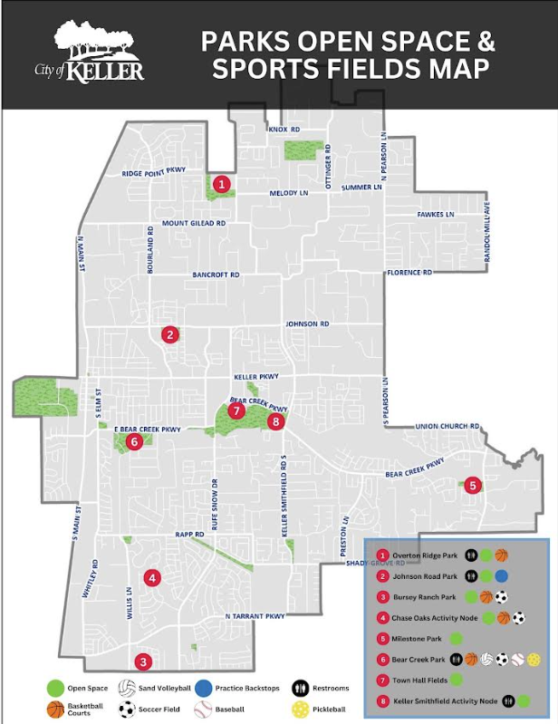
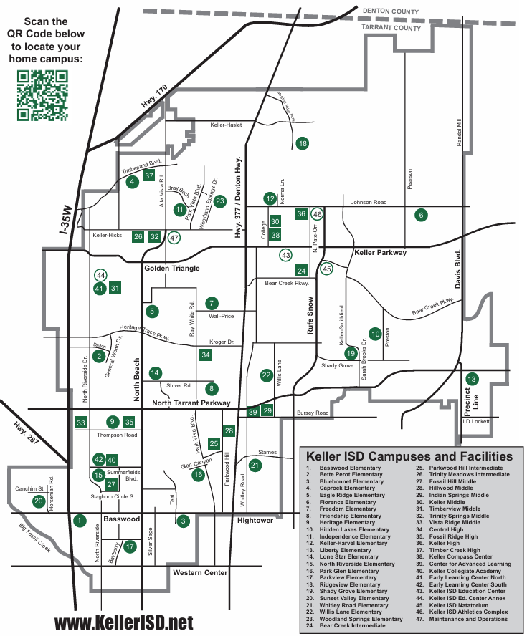
PARKS & SCHOOLS IN OUR AREA
8

Slide 10
PART 2
SEASON FLOW
How the season runs, from league play to game day to the final whistle

Slide 11
LEAGUE PLAY & LOCATIONS
U5 - U8
U9 - U19
KSA vs. KSA
Northern Mid Cities Soccer League (NMCSL)
All games played at the KSA Soccer Complex
One home base - easy for families to plan around
At least 50% of games at the KSA Soccer Complex
Up to 50% played at neighboring associations
U11-U19 players cannot play on multiple North Texas rosters, even across different leagues - no recreational team plus a competitive team, including any US club roster.
10

Slide 12
GAME DAY STANDARDS
Ensure 50% play time - prepare a lineup and substitution plan in advance. No exceptions in the rec league, even if a player missed practice.
No jewelry or uniform adornments; shin guards required at all times
Coaches stay in the designated technical box; parents and coaches stay off the field and on opposite sidelines unless invited by a referee
Prefer 2 coaches per sideline (up to 3) - KSA coach ID must be visible
Uniform conflict: home team changes or wears pinnies (borrow from either concession stand)
Home team enters the score in GotSport within 48 hours; never enter a forfeit yourself - call your commissioner
No scores kept for U8 and under - focus on skills, sportsmanship, fun, and confidence
AEDs, first aid, and ice packs are at Concessions B and E (and the golf cart)
11

Slide 13
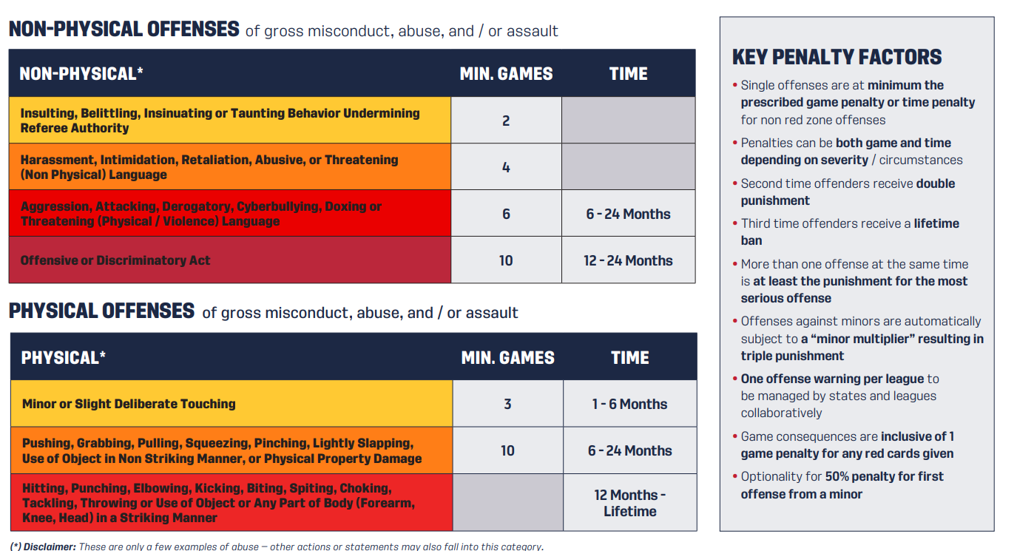
REFEREE RELATIONS & ZERO TOLERANCE
Zero Tolerance: dissent toward any official - yelling, belittling, ignoring instructions - leads to an Appeals & Disciplinary hearing. Coaches are responsible for parent conduct too.
New Referee Abuse Prevention Program (US Soccer, effective March 2025) sets escalating, tangible consequences - see the penalty chart at right.
Never argue a call in the moment.
  Wait 24 hours, then send a written report to your age group commissioner only - they'll work it with the Director of Referees.
OK to ask: “Can you explain what you saw?” Not OK: challenging or threatening a call
Find a Field Monitor for more urgent issues, but respect their position
12

Slide 14
WEATHER, RAINOUTS & RESCHEDULES
Follow @kellersoccer on Facebook (fastest) - check kellersoccer.net too.
Lightning detection system on-site - always abide, even if it looks clear where you are.
Games reschedule only if a team can't field the league minimum (see the Pocket Reference Guide) - not for coach absences, so keep 2 background-checked assistants ready.
Known conflicts (school, church, scouting) go to your commissioner in writing within 48 hours of schedule publication.
To request: submit the Reschedule Request Form (Coaches Corner) with 3 alternate dates → commissioner reviews → Scheduler/President approve. Not guaranteed - reviewed case-by-case.
______________________________________________________________________________
Timeliness of Requests… Sooner the Better
Start of the season – Give you until the first game to turn in any schedule request due to Fall Break
48 hours after a rainout or rescheduled match has been put on the calendar
13

Slide 15
KEY DATES
Aug 29th
Keller Kickoff – Coach’s Clinic, Referee Training, Scrimmages, Small-Sided games, General Meeting
~1 week before opener
Schedules published
Week before season
Uniforms ready at Soccer Post - wait for your commissioner's go-ahead
Sep 12
Season starts - 8 games for all age groups
Oct 3 & 24
Picture Days
TOC Intent To Enter
14
Mid October (Not Published Yet)
Nov 14
Last weekend of regular season
Uniform pickup timing varies by supply chain - please wait for your specific team's go-ahead rather than a general date.
14

Slide 16
RESOURCES, CONTACTS & PARTNERS
Coach Resources
  kellersoccer.net - bylaws, Quick Reference Guide, Coaches Corner | GotSport coach account | NTX Soccer coaching education program
General Contact
  kellersoccer@verizon.net | 133 Sports Parkway, Suite F | Office hours Tue/Thu 9:30a-1:30p | Follow @KellerSoccer for news and rainouts
Local Business Partners
  Dick's Sporting Goods - 20% off coupon at KSA office / kellersoccer.net | Soccer Post - uniform pickup & gear
See the Pocket Reference Guide on the next page for age-specific format rules (roster size, field size, game length, and more).
15

Slide 17
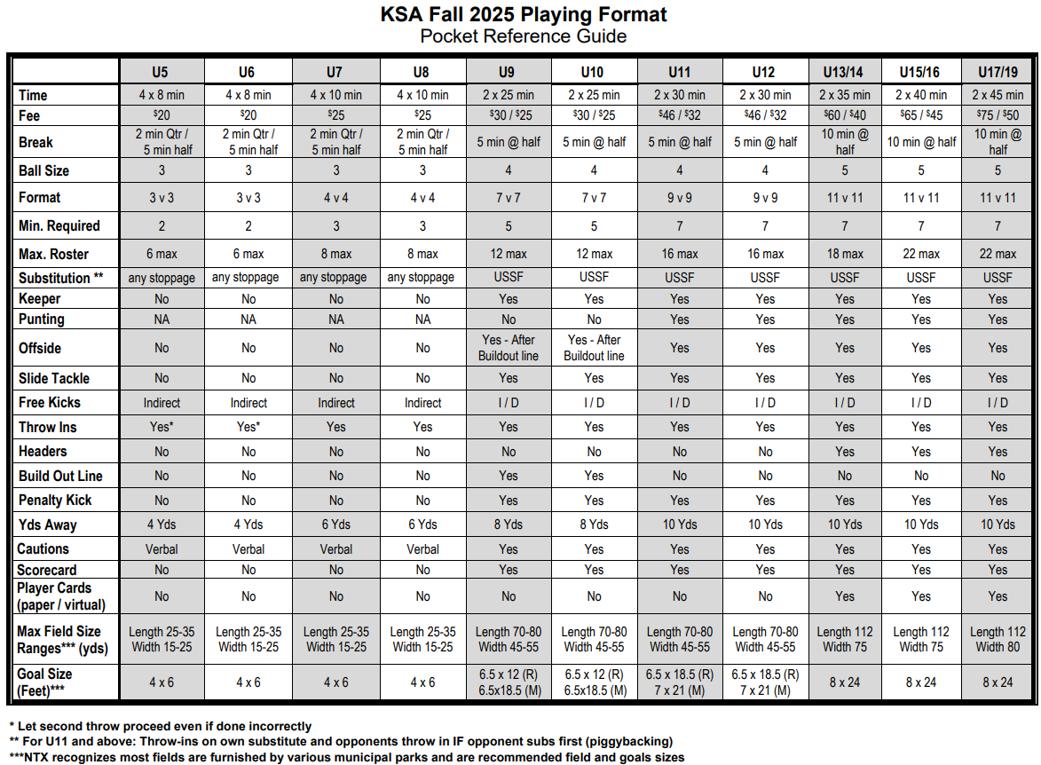
POCKET REFERENCE GUIDE
16

Slide 18
Remember to scan the QR code to check in for the Coach's Meeting
KSA COACHES MEETING
Thank You for Coaching
17

