Slide 1
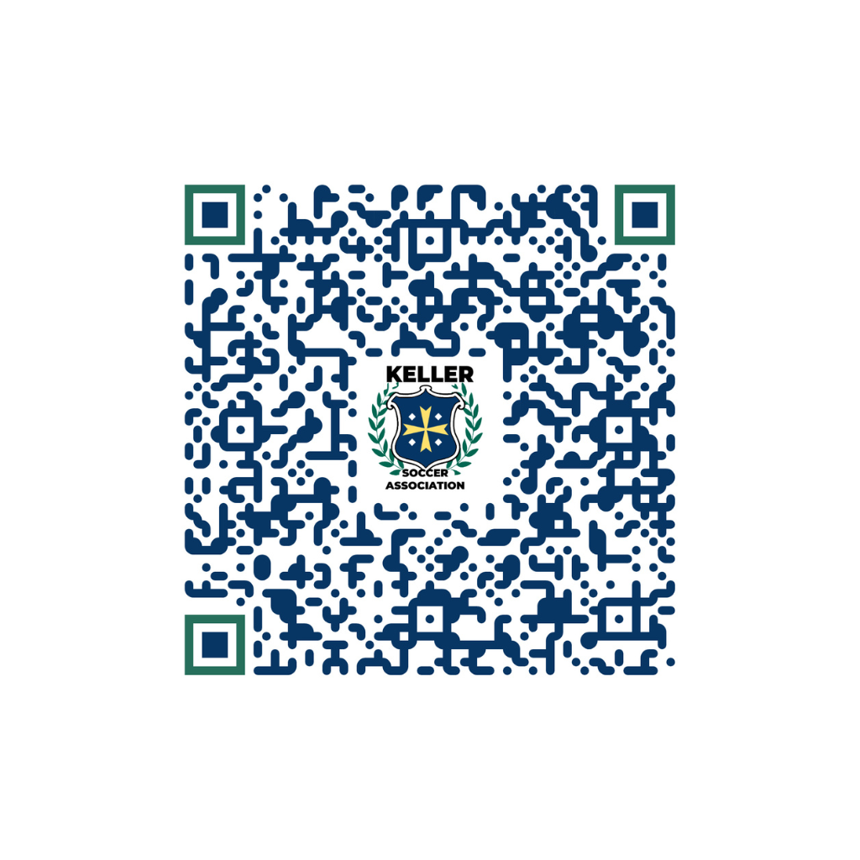

KSA COACHES MEETING
Scan the QR code to check in for the Coach’s Meeting
FALL 2025
1

Slide 2
TOP 5 TAKEAWYS
Rosters
  Notify of any known roster issues asap, to help with uniform ordering
Game Day Musts
  U9 & up – Must have jersey #’s into gotsport rosters
  Bring 2 printed game reports with coaches listed and all players with jersey #’s
  Coaches must have printed badges visible at all times while on sideline
  NMCSL – not doing so, could result in a forfeit
  Players bring both jerseys to every game (Make sure it is their jersey)
Coach/Player/Parent Conduct
  Zero Tolerance and New Referee Abuse Prevention Program
  Coaches are responsible for parent behavior (set expectations)
No Earrings & Must have shin guard
Reach out to your commissioner for help
2

Slide 3
KELLER SOCCER ASSOCIATION
Non-Profit Organization under NTX Soccer
U9-U19: NMCSL (Northern Mid Cities Soccer League) Recreational League – 80+ teams
U8 & under: KSA Recreational League – 70+ teams
1500+ players this season
150+ coaches
100+ referees
3000+ parents, grandparents, sideline coaches, etc…
We are a 100% volunteer organization
3

Slide 4
MANDATORY
COACH REQUIREMENTS
Do on-line Coach Registration. This is how we know you are coaching for us, how we can assign you to a team and how you get emails from the association
Background Check
SafeSport Certification - Initial or Refresher: Product of the Protecting Young Victims from Sexual Abuse and Safe Sport Authorization Act of 2017. Only one time doing full course, then 15-30 min refresher each year (linked to BG check)
  Use your legal names in both Gotsoccer and SafeSport AND the same e-mail your coach account is under.

Slide 5
US SOCCER – TEAM FORMATION
Please understand it is NOT “your” team. You cannot ask KSA to not put certain players on and/or take certain players off, and please do not say yes or no if someone asks if they can be on “your” team.
Team placements (Calendar Age Rules):
  Returning team age assignments are based upon the age of oldest player on the roster
Returning players may:
  Automatically return to their previous team - the Gotsport system controls this. It does not matter what else they try to put in other drop downs, in the notes etc.. If they do not mark return to draw, they will always go back to their previous team
  Elect to go into the draw
  May elect to stay in calendar age group, despite team
  May request to play up one age group, without board approval
New players may:
  Request “buddy rule” if they have NOT played with any NTX association
  within the past two seasons. It is a REQUEST!!! Many times, teams are already full.
  Request to play in calendar age group or request to play up
    Coach and Parent Roster Questions/Concerns must be directed to
    the KSA Office via email, for vetting/evaluation, to ensure NTX Registration and
    Roster Compliance.

Slide 6
PRE-SEASON PREPARATIONS
Contact Team – within 48 hours of receiving roster
  Establish practice days/locations (centrally located to all)
  Recruit volunteers (assistant/team manager/team mom or dad, etc.)
    Ensure background checks, registration, safe sport course
    Notify commissioner ASAP if adding a volunteer to your team
      Must be added to roster to be on the sideline
      Verify on your printed rosters before your games
  Let your commissioner know asap about any roster concerns, so we can get any last minute changes before uniform orders
  Coach’s card NEED to be printed and on a lanyard and visible to the referee crew (at least during the roster check in process)
    NMCSL has moved towards a stricter visual policy
6

Slide 7
PRACTICES
No more than three soccer events per week
  Includes games
  Suggest no more than 1-hour practice
KSA does not have designated practice fields and the City of Keller does not permit use of game fields for practices, outside of organized development/skills programs
NEVER allow bullying of each other by your players.
Equipment – Water, ball, shin guards
  Cleats (not required), however must be soccer cleats if worn
Emphasis should be on technical skills, tactical skills and fun!!!
  Create games to teach skills “Make Practice Fun”
  Environment of teamwork and positive reinforcement
  Build confidence and morale
  Come prepared with a practice and game plan
    Outline practice to maximize touches, reduce stale time
7

Slide 8

RESOURCES
Coach Resources
  KSA website – www.kellersoccer.net
    KSA Bylaws
    Quick Reference Guide
    Coaches Corner
  Got Soccer – www.gotsport.com – Coach Account
North Texas Soccer – Grassroots Program
  https://www.ntxsoccer.org/coaching/coaching-education-program/
  KSA is hosting 2 courses – 7v7 online Aug 19 and 9v9 online Aug 20 with on field instruction on Saturday, August 23rd. See Coaches Corner for registration link and details
Apps!!!! Lots of soccer applications out there for you to use, plus YouTube etc. Most popular and useful app seems to be Mojo Sports: It sends you practice plans for each practice and even included videos
Challenger Soccer Skills:
  Monday & Wednesday nights
  6 weeks of supplemental skill sessions starts on Monday, Sep 8th
8

Slide 9
GAME DAY STANDARDS
KSA Standards
Ensure 50% play time: prepare a line-up in advance; with substitution plan
  Recreation league - no exceptions! Even if players don’t make practice…
Review Quick Reference Chart for age specific rules
  Quick reference guides at link www.kellersoccer.net, meets U.S. Soccer standards
No Jewelry or Uniform Adornments
KSA has designated coaches' technical boxes, coaches must remain in designated area
Parents and Coaches, please, stay off fields; unless invited by a referee
Parents and Coaches on opposite sides of field @ KSA. Observe away associations protocol.
Prefer two coaches per sideline, up to three allowed. MUST have KSA coach ID visible
No scores are recorded in U8 and younger play
  - FOCUS ON SKILLS, TACTICS , SPORTSMANSHIP, FUN and CONFIDENCE BUILDING
AEDs – automated external defibrillators are located at Concessions B and E
Large First Aid Kits and Ice Packs are available at Concessions B and E; and on the golf cart
Coaches are responsible for parent behavior – educate during pre-season team meetings
9

Slide 10
GAME DAY STANDARDS
Miscellaneous
If uniform conflicts, home team must change or wear pinnies. Pinnies can be borrowed from either concession stand.
Game reports from Gotsport for U9+ age groups
Spirit of the Game (6 goal differential – don’t celebrate others misfortune)
  You get no additional points in rank for more goals, there is a max
Home Team enters score in Gotsport within 48 hours.
  If home team doesn’t do so within 48 hours, you may enter them. Any errors, notify your Commissioner
  DO NOT enter forfeits – tell Commissioner
Issues/questions:
  Find a Field Monitor
  Contact your age group Commissioner
    All concerns must be documented and submitted to the age group commissioner
    No on-park disputes with referees are tolerated, please allow
    your Commissioner to address matter with referee director and board
10

Slide 11
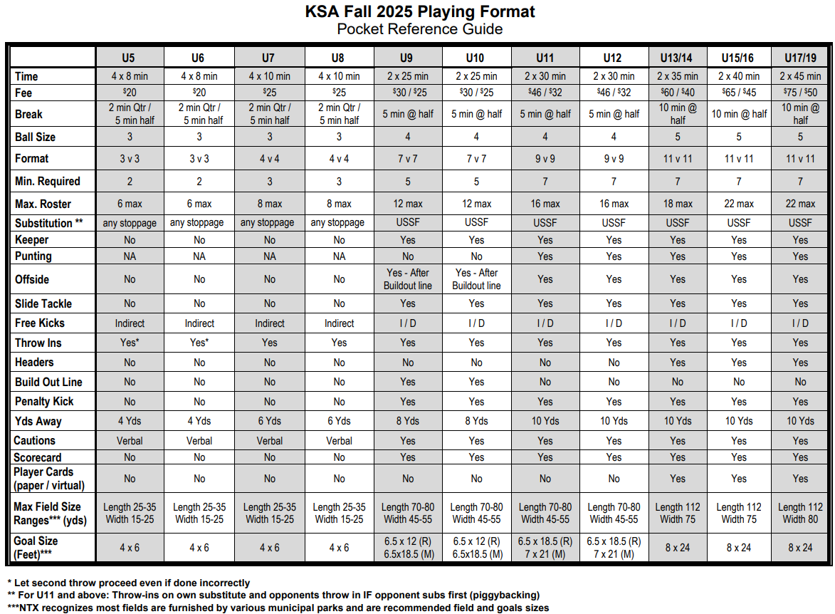
POCKET REFERENCE GUIDE
11

Slide 12
League Play
League Play & Locations
U5 - U8 – KSA vs KSA
  All games at KSA Soccer Complex
U9-U19 - Northern Mid City Soccer League
  At least 50% of games will be at the KSA Soccer Complex
  Up to 50% of games will be played at neighboring associations
U11-U19 Players cannot play on multiple North Texas rosters even if they are in different leagues
  No recreational team plus a competitive team
  This includes any US club roster
12

Slide 13
ZERO TOLERANCE
Zero Tolerance Policy – KSA Standards are to provide a peaceful playing environment
Yelling at, belittling, not following instructions from a referee or game official; or any other form of dissent toward any game official will result in an Appeals and Disciplinary Hearing, before the KSA Board
Coach is responsible for the conduct of parents
Disrespectful conduct such as confronting referees is an A/D violation
  Violations can result in suspension of players, dismissal of coach, forfeit of game
  Violations NOW may include YELLOW AND RED CARDS, as well as disciplinary action from verbal/written warnings, community service up to dismissal from coaching at KSA for the season or longer
Coaches must track cumulative yellow and red cards of players
  Excessive red cards will result in player A/D hearing
  Rules are available www.kellersoccer.net
Do not argue calls with referees (home or away)
  Wait 24 hours
  Coach ONLY write a formal report to the age group commissioner for review
  Commissioner will address with the Director of Referees
  Commissioner will report back to coach
  KSA does not oversee other association referees
    A/D Chair will forward written reports
13

Slide 14
REFEREES
We are developing referees like you are developing players
They are learning to be refs
We are having to identify and develop referees from single ref to three person crews
KSA Standards
Zero Tolerance – Will be STRICTLY enforced!! We, and US Youth Soccer as a whole, are losing referees at an alarming rate because of rude, screaming, disrespectful, degrading etc., coaches and parents!!! Please control yourself and your parents!!
  Recreation league - no exceptions!
  It’s okay to ask questions – it’s not okay to challenge or threaten
  Screaming at referees is not going to make them better
Things that are okay to ask at half time or after game:
  Can you explain what you saw?....Thanks
  On that call (insert details) how did you see it play out?....OK Thanks
Not okay
  Maybe if we got some calls they wouldn’t foul so much!
  You need to call the game both ways!
14

Slide 15
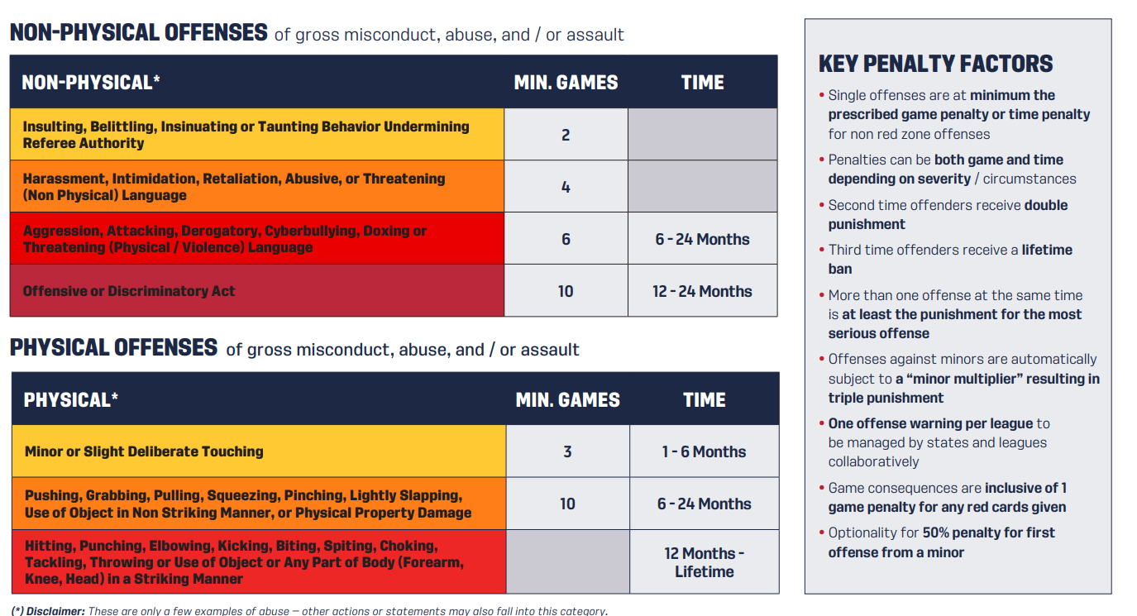
REFEREE ABUSE PREVENTION
US Soccer Board effective March 2025
Due to continual abuse to referees
Goal is to have consistent tangible consequences
15

Slide 16
GAME DAY LOGISTICS
Game Locations (KSA / NMCSL Fields)
Rainouts, Reschedules – Real Time Updates:
  Like us on Facebook (Fastest Method)
  Follow us on X
    These two mediums will be invaluable to you and your parents this upcoming season
    Same for other associations
  User names are @kellersoccer
  Check web – Field Status updated as quick as possible
    www.kellersoccer.net
  Lightning detection system on the field – Perry Weather PLEASE ABIDE!!! Even if it doesn’t “look” bad where you are. Here’s an example why:
    https://www.weather.com/storms/severe/video/lightning-strikes-out-of-nowhere-on-sunny-day-in-florida?pl=pl-the-latest
  Most games will be rescheduled, unless game progressed to 1st touch in second half.
    Coach is responsible for checking web site for reschedules
16

Slide 17
RESCHEDULE REQUESTS
Rescheduling Policy :
Coaches may ONLY request reschedule if the team is unable to field a minimum squad (see Pocket reference guide for minimum for each age)
  Per KSA bylaws & for reasons limited to school, church and scouting events
  Reschedules not made as a result of coach absences – therefore suggest at least 2 assistants who are registered/background checked
  Reschedules are not guaranteed, are field/referee availability dependent; and NMCSL may decline, resulting in forfeit
Pre-season known schedule conflicts must be provided to the age group commissioner in writing within 2 days (48 hours) of schedule publications, for opening weekend
  Obtain from parents prior to schedule publication
    Example: large known school or scouting events
    Please get those to the age group commissioner ASAP! Same for coaches that coach more than one team.

Slide 18
RESCHEDULE REQUESTS
Rescheduling Policy - Continued:
Reschedule requests shall only be considered when submitted in writing on the appropriate form.
  Reschedule request forms are available online under Coaches Corner.
  Coaches shall complete form and email to their commissioner – provide 3 alternate dates, not guaranteed
  Commissioner will review and determine eligibility, forward to Scheduler and President for approval
  Scheduler will notify Commissioner of rescheduled date/time
  Commissioner will notify coach of new game/time
Reschedules are reviewed on a case-by-case basis

Slide 19
KSA LOCAL BUSINESS PARTNERS!!!
Dicks Sporting Goods – Alliance Town Center
  KSA Discount coupons @ Keller Soccer Association Offices and kellersoccer.net. 20% off entire purchase form on the upcoming Dick’s Sporting Goods weekend
Soccer Post – Denton Hwy
  More soccer specific (player, coach and referee gear)
  Great partner to help with our uniform distribution
Kroger Rewards
  Set up your community rewards to go towards Keller Soccer, which we will use for future scholarships.
  PLEASE TELL ALL YOUR PARENTS!!!
19

Slide 20
KEY DATES
Schedules should be out approx. 1 week before opening weekend.
  Remember for U9-U19, we’re coordinating with multiple associations, fields and different schedulers
Uniforms should be ready for Coaches to pick up at Soccer Post the week before the season starts, BUT PLEASE WAIT UNTIL YOUR COMMISSIONER TELLS YOU THAT YOUR TEAMS IS READY! We do them individually and specifically for each team, not just batches.
Please understand that there are many logistical as well as supply chain issues that are out of our control, and therefore the later pick up of uniforms this season.
Saturday September 6th: Season Starts.
8 games for all age groups
Picture Days: Sept 13th and 20th
Last weekend November 16th
20

Slide 21
KSA - KEY CONTACTS
General Contacts
  kellersoccer@verizon.net
  Follow us on Twitter and Instagram @KellerSoccer
  Like us on Facebook @KellerSoccer
  Office hours Tues/Thurs (9:30a-1:30p)
    133 Sports Parkway, Suite F, Keller TX 76248
KSA BOARD
  www.kellersoccer.net
    Contact Info - Tab
Rainouts
  www.kellersoccer.net
  Facebook & Twitter are most timely and highly recommended
21

Slide 22
Rosters & Game Reports
Rosters
  View your team roster - from your gotsport account
  Team Management -> Team Name -> Rosters -> Select Event Roster = KSA Fall 2025 Season -> Search ->
    Players & Coaches tabs (Check to make sure you and your AC’s are there)
      Drill down on player for contact info
    Roster PDF Button -> Hard Copy
Game Reports
  Team Management -> Matches - > Find Specific Game # -> Far right under ‘Chat’ Column click the 3 dots (...) -> Print Match Cards -> Export
  Should have both team’s NTX approved players & coaches
  If your AC is not on here, that means they are not approved and/or moved over to your roster.
Coaches Badge & Player ID’s
  Same as Roster above, but hit ID cards instead of roster
  Print hard copy for coach ID’s & for U13+ players
  Available on the gotsport app
All available on the Gotsport App
22

Slide 23
KSA COACHES MEETING
Remember to
scan the QR code to check in for the Coach’s Meeting
Thank You for Coaching
23

